Slide 1
MONITOR NOISE POLLUTION IN PUBLIC AREAS WITH IOT SENSORS

Slide 2
INTRODUCTION
Presently, noise pollution has become a very big issue around the world. The adverse effects of this pollution include hearing impairment, negative social behavior, annoyance, sleep disturbance and intelligibility to understand people’s speech. In learning context, noise can affect understanding and behavior of people and places with high noise level are not suitable for learning and teaching process. Internet of Things (IoT) technology is one of the best choices to monitor the noise or sound intensity in the environment for the safety of human being. The aim of this paper is to deliver a development of an IoT based noise monitoring system comprises of a sound sensor, an IoT platform called NodeMCU, LCD and LEDs. The system will provide a real-time alert if the noise exceeds the threshold noise limit set by Environmental Department of Health standard. Equipped with an Android application, the data from the sound sensor will be transferred into the cloud server and subsequently transferred into the app for display and to enable remote monitoring. A case study is carried out using the developed prototype to ascertain the noise comfort for Universiti Teknologi Malaysia (UTM) students for studying or learning purpose. The sound level is measured for two different days during weekend and weekday. Based on Charted Institution of Building Service Engineers (CIBSE), 60dBA is the permissible ambient level and any readings that above 60dBA can interrupt speech intelligibility.
From the research, the suitable time for students to study for weekend is all day starting from morning until midnight. As for weekday, the most suitable time to study is during midnight. These justifications are made based on the readings of the sound level.
.

Slide 3
OBJECTIVES
The main objective of this research is to propose a modular and scalable solution for enhanced health and wellbeing using Internet of Things and mobile computing technologies. The main is to present a real-time monitoring system for enhanced acoustic comfort with mobile computing compatibility for data visualization, analysis and notifications. The results state the proposed system as an adequate sound supervision for enhanced acoustic comfort and wellbeing. The system has been tested in a laboratory using continuous real-time data collection mode for two months. The average sound levels range from 47.25 to 52.99 dBA and from 46.22 to 51.84 dBA grouped by the day of the week and hour of the day, respectively. Continuous real-time monitoring is relevant for enhanced living environments since the analysis of the noise pollution levels of the ecosystem where the patient lives can be related to his health symptoms. Moreover, the proposed method present advances in installation and configuration, due to the use of wireless communications technology, and is also compatible with generic buildings.

Slide 4
IMPORTANCE OF NOISE POLLUTION
Noise pollution is the spread of unwanted sounds into the environment.
Noise is almost always around us, whether natural, such as birdsong, or from human activity, such as vehicle traffic. However, noise build-up can have a significant impactTrusted Source on the well-being of humans and animals.
Compared to other types of pollution, people often overlookTrusted Source noise pollution as a health hazard. However, many people are experiencing a rise in noise pollution due to an increase in human activity.
Impact on mental health
Unwanted sounds can have a range of mental health effects.
The brain is always monitoring sounds for signs of danger, even during sleep. As a result, frequent or loud noise can trigger anxiety or stress. With continued exposure to noise pollution, a person’s sensitivity to stress increasesTrusted Source.
People living with noise pollution may feel irritable, on edge, frustrated, or angry. If a person feels they cannot control the amount of noise in their environment, its impact on their mental health intensifies.
Environmental noise is also a common cause of sleep disturbance. A person may experience:
difficulty falling asleep
inability to stay asleep
waking too early
Sounds can also reduce the depth and quality of sleep, altering the amount of rapid eye movement sleep. This can impact a person’s mood and ability to concentrate.

Slide 5
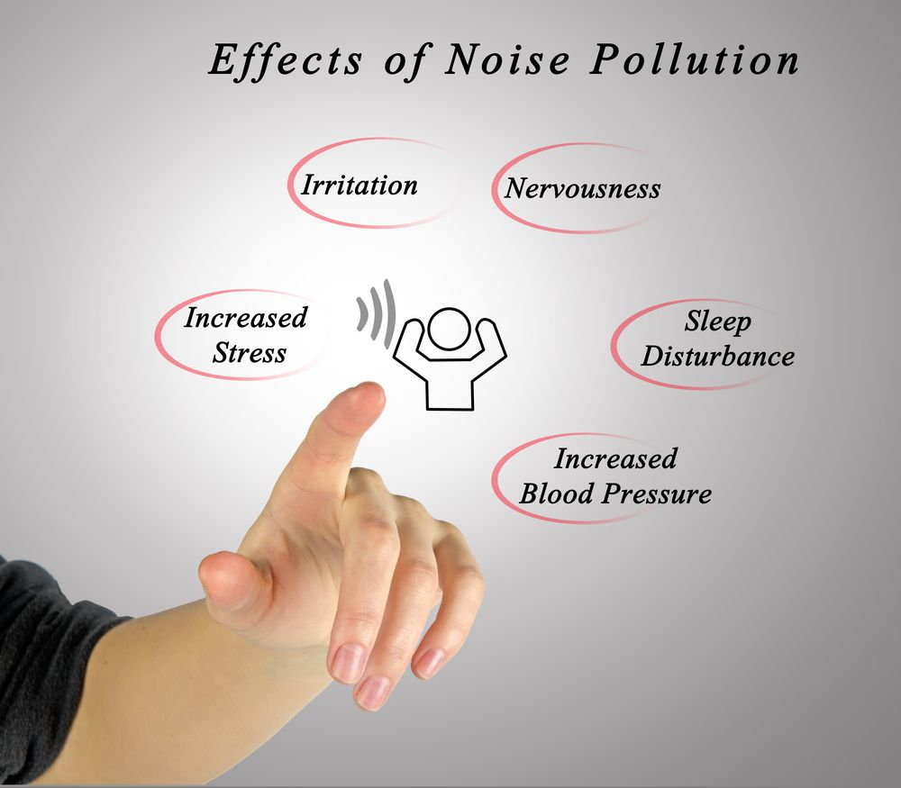

Slide 6
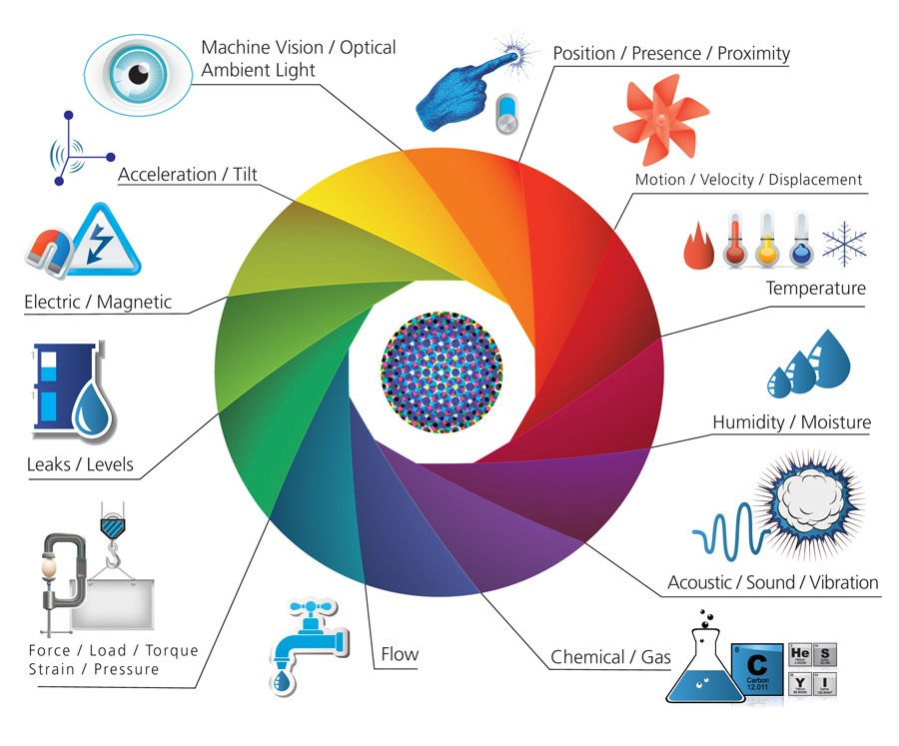
IOT SENSOR SYSTEMS

Slide 7
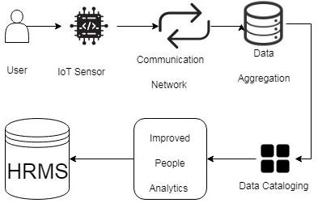
IOT sensor noise level data in real time data collection

Slide 8
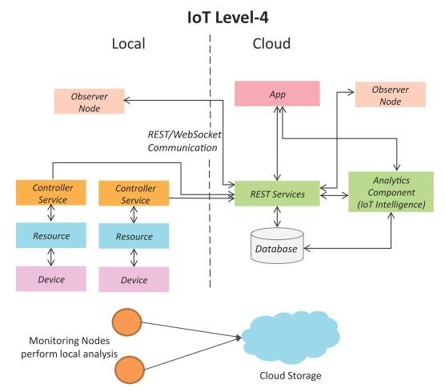
DATA PROCESSING

Slide 9
Collecting and analyzing sensor data from IoT devices
In this article, we will explore a Python-based system that collects sensor data from various IoT devices and calculates the average sensor value for each device type while maintaining a sorted list of average values. This use case demonstrates the importance of real-time data processing and analysis in IoT systems. By analyzing the sensor data, we can monitor device performance, identify trends, detect anomalies, and optimize the overall operation of an IoT system.
In the following sections, we will first provide a basic Python implementation of the use case, followed by a more advanced version that simulates real-life scenarios, complete with error handling and validation checks. Along the way, we will break down the code step by step, ensuring a clear understanding of the concepts and implementation details.

Slide 10
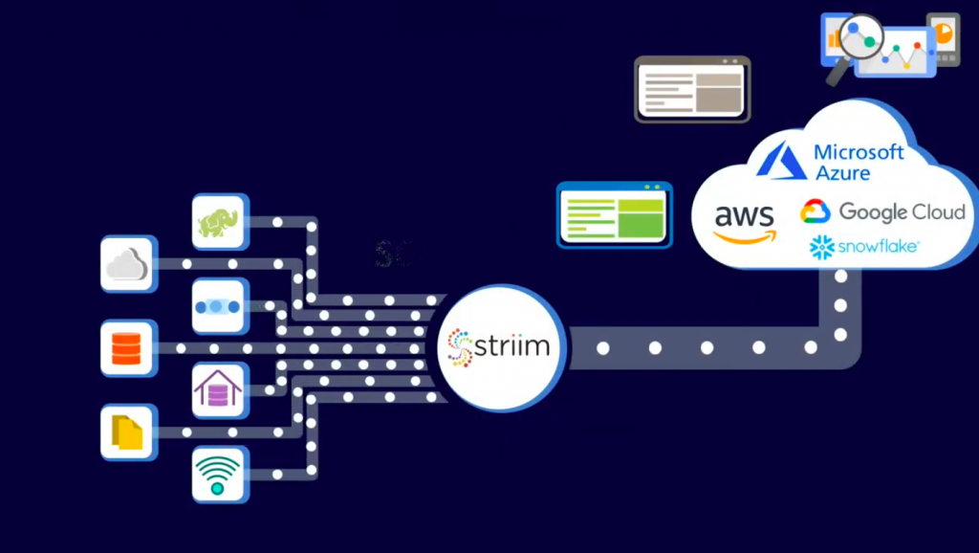
real time data access

Slide 11

Advantages of IoT-Based Noise Monitoring
1.Real-time Data Collection
IoT devices excel in providing real-time data collection capabilities for noise monitoring. By continuously capturing and transmitting data, these devices offer an accurate and up-to-date understanding of noise levels in urban environments.
This real-time data allows authorities to respond promptly to noise disturbances, ensuring a more efficient and effective management of noise pollution.
2. Scalability
The modular nature of IoT systems makes them highly scalable. As urban areas expand and evolve, additional IoT sensors can be easily deployed to cover a wider area.
This scalability ensures that noise monitoring efforts can keep pace with urban growth and effectively adapt to changing noise patterns.
Whether it’s expanding the sensor network to new neighborhoods or incorporating IoT devices into transportation systems, scalability is a significant advantage of IoT-based noise monitoring.

Slide 12

3. Cost-effectiveness
IoT devices have witnessed a significant reduction in costs over the years, making large-scale deployments of noise monitoring systems more feasible.The decreasing prices of sensors, connectivity, and data storage have lowered the barriers to entry for cities and organizations seeking to implement IoT-based solutions.This cost-effectiveness opens up opportunities for wider adoption, enabling more cities to benefit from the advantages of real-time noise monitoring.
4. Data Analysis and Insights
IoT platforms offer advanced analytics capabilities that enable meaningful insights to be derived from noise data. By employing sophisticated algorithms and machine learning techniques, these platforms can analyze vast amounts of data to identify trends, patterns, and correlations.
These insights can help urban planners, policymakers, and researchers make evidence-based decisions regarding noise control measures, urban design, and public health interventions. The ability to extract valuable insights from noise data sets IoT-based noise monitoring apart from traditional methods.

Slide 13
5. Remote Monitoring
One of the significant advantages of IoT-based noise monitoring systems is their ability to be remotely managed and accessed. Through secure online platforms, authorized personnel can monitor noise levels, configure sensor settings, and access data from any location with an internet connection.
This remote monitoring capability reduces the need for frequent on-site interventions and allows for efficient management of noise monitoring systems, even across vast urban areas.
6. Integration with Smart City Infrastructure
IoT devices seamlessly integrate with other components of smart city infrastructure, enabling holistic urban management. By integrating noise monitoring data with data from other sources such as traffic management systems, environmental sensors, and public safety networks, cities can gain a comprehensive understanding of the urban environment.
This integration facilitates more informed decision-making, as noise data can be correlated with factors such as traffic flow, air quality, and public health indicators. Such integration creates synergies among various smart city initiatives and helps in the development of comprehensive strategies for noise pollution control.

Slide 14

Conclusion
People thought that noise pollution is merely an annoyance but it is actually very important to
monitor noise level because according to research, people who are exposed to noise for a long
duration of time can have hearing loss, sleep disturbance, high blood pressure and injuries.
Besides, it can affect the learning process of people in terms of understanding and behaviour.
Thus, this research investigates and subsequently proposes the suitable time for students to study
by utilising the cloud server and android application to realize an IoT based noise monitoring
system. From the prototype, it also can be determined the dominant sound that increases the noise Level in the researched area. The app can display the reading from the prototype successfully.
Based on the results, it can be concluded that the students can study throughout the day starting
from morning until midnight during weekends because the noise level is still under the allowable
standard which is 60dBA according to CIBSE. As for weekdays, the suitable time to study is
found out to be at midnight because the readings are below 60dBA for that time. The limitation of
this study is that it is conducted within UTM campus only. In addition, the app can only show the
reading from only a single prototype as well as the prototype and app can only operate when there
is an internet connection. This system can be improvised in future to include measurements
outside UTM such as at schools and airports

Slide 15
THANKYOU

